Slide 2
Contents
Relationship between economic growth and the environment
What happened in Japan
Environmental policies
Conclusion

Slide 3
Relationship between economic growth
and the environment

Slide 4
The general idea is that…
Economic
growth
More
production
More
pollution
Environmental damage

Slide 5
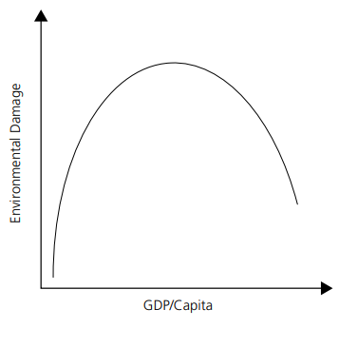
Environmental Kuznets
Curve (EKC)
Turning point
Technological progress
Behavior change
Lewis growth model
Sustainable economic growth(?)

Slide 6
What happened in Japan
~negative legacy that the high economic growth left~

Slide 7
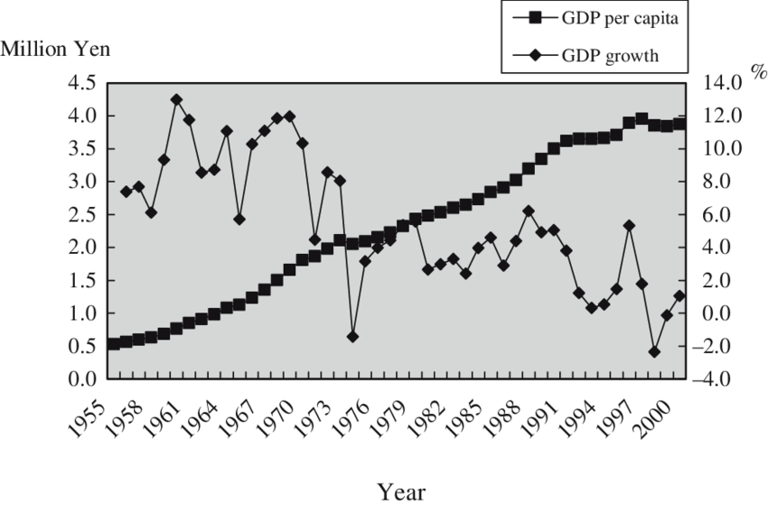
High economic growth

Slide 8
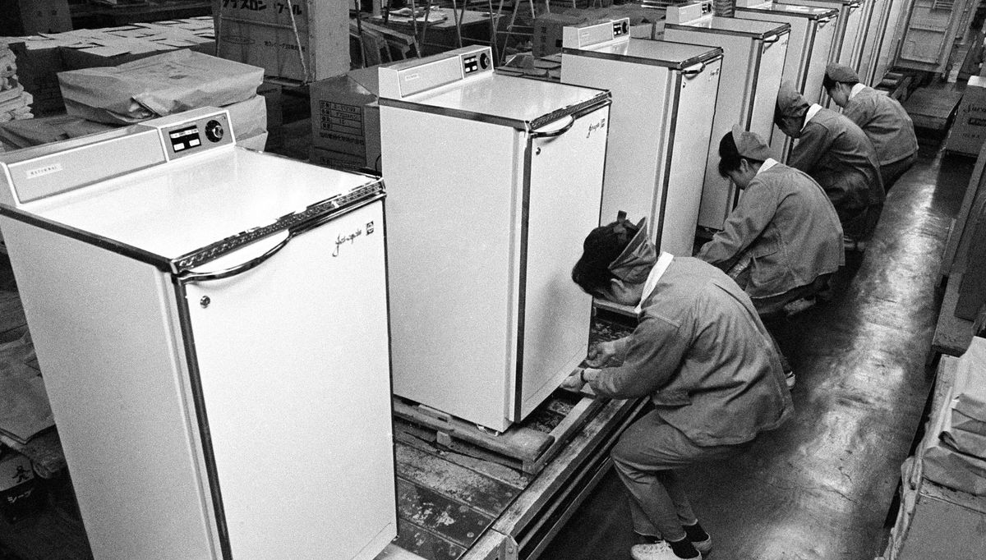
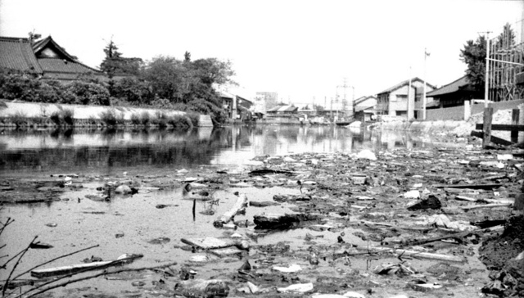
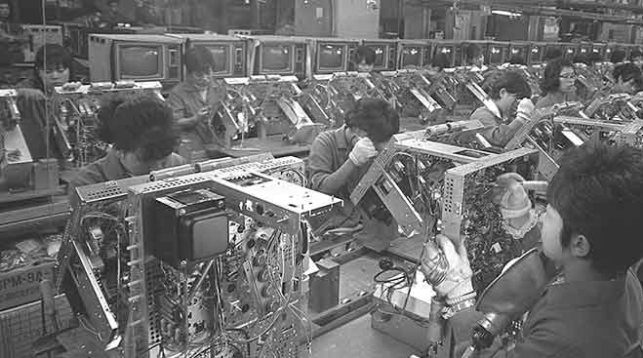
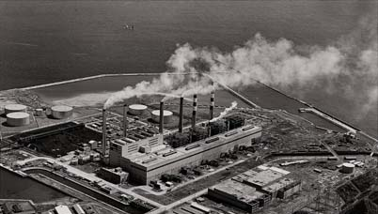
Gallery
This resulted in…
What it looked like

Slide 9
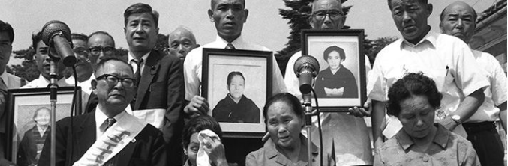
Four Big Pollution Diseases of Japan
Itai itai disease (cadmium)
Yokkaichi asthma (sulfur oxide)
Minamata disease (inorganic mercury)
Minamata disease 2
Loss of lives because of pollution…

Slide 10
Why did this happen?
It happened because the Japanese/local government:
missed signs from nature (fish/trees)
never did proper research/hid the research
ignored protests from local people
Lack of environmental policies

Slide 11
Environmental policies

Slide 12
“Impact of the policies on the economy?”
WAYS TO MINIMISE THE EFFECTS

Slide 13
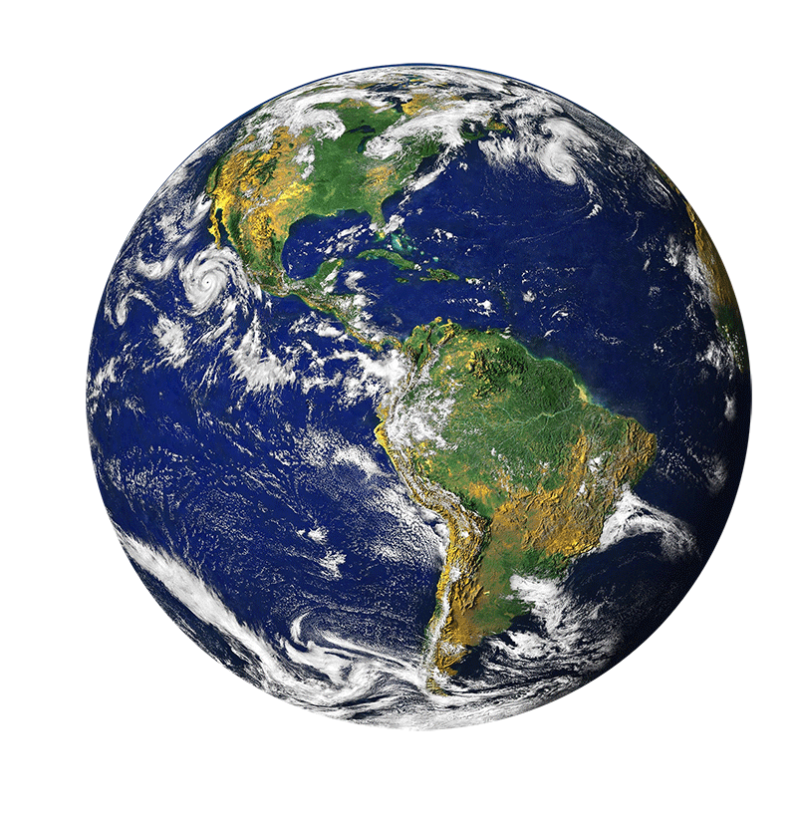
Conclusion

Slide 14
Thank you for listening!
Shinnosuke Sakamoto

